Slide 1
Personality Prediction using Support Vector Machine
University of Technology ( Yatanarpon Cyber City)
Faculty of Information and Communication Technology
Department of Information Science and Technology
(First Seminar)
Supervised By Presented by
Dr. Yi yi Hlaing zwe htet paing ( 6IST-70 )
24-7-2019(Web)

Slide 2
Outline
Abstract
Objective
Introduction
Scope of Thesis
Preprocessing
Model
Future Work

Slide 3
Abstract
The system predicts the personality traits of Social media users based on posts they uploaded and shows predicted Big 5 model scores.
The system might benefit from understanding the relationship between personality and use of social media.
The system predicts the personality of Twitter users using Support Vector Machine (SVM).
The system can be very useful for career progression, job satisfaction and setting preferences in different interfaces.

Slide 4
Root Mean Square Error (RMSE) is the standard deviation of the residuals (prediction errors). Residuals are a measure of how far from the regression line data points are; RMSE is a measure of how spread out these residuals are.
The formula is:
Where:
f = forecasts (expected values or unknown results),
o = observed values (known results)

Slide 5

R^2 (coefficient of determination) is regression score function. Best possible score is 1.0 and it can be negative (because the model can be arbitrarily worse).
R^2 = 1 - residual sum of square / total sum of squares.

Slide 6
Objectives
To know about what type of person you are.
To investigate the predictability of the personality traits of social media users and customers based on text and measures of the Big 5 model.
To understand Support Vector Machine

Slide 7
Introduction
Nowadays , a lot of information are shared by users during their social media usage.
That presents an opportunity for an automated analysis of a social media user based on his/her information, activities, or status updates.
One of the information that can be analyzed from social media usage is user’s personality.
Personality is made up of the characteristics, patterns of thoughts, feelings, and behaviors, which makes a person unique.

Slide 8
Introduction(Cont’d)
Personality has been found to significantly correlate with a number of real-world behaviors and also influences how people interact online.
The relationship between real-world social networks and personality has been usually studied using a personality test called “The Big Five”.
The personality prediction system for this study is built to classify a user’s personality using SVM.
The prediction results are based on The Five Factor Model, a personality model by McCrae and Costa, which divides an individual’s personality into 5 traits.

Slide 9
Cont’d
The Five traits are namely Agreeableness, Conscientiousness, Emotional Stability, Extraversion, and Openness.
Openness indicates how open-minded a person is . A person who is high in Openness are imaginative, curious, and open-minded.
Conscientiousness is about how a person controls, regulates and directs their impulses
Extroversion is characterized by sociability, talkativeness, assertiveness, and excitability.

Slide 10
Cont’d
Emotional stability refers to a person's ability to remain stable and balanced. At the other end of the scale, a person who is high in neuroticism has a tendency to easily experience negative emotions.
Agreeableness relates to a focus on maintaining positive social relations, being friendly and cooperative.

Slide 11
Scope of Thesis
The users need to login into the system with their social media account.
The system crawls the real time social media data called tweets from twitter using Twitter REST API.
The system crawls about 100 tweets for each user and these tweets are input of the system, then the model predicts user’s personality base on these tweets.
And the system will output five personality trait with relevant percentage value and Yes/No for each trait.

Slide 12
Data Pre-processing
The system need to make sure that the information we pass the model is in a format that computers can understand.
Therefore , first is to remove any unnecessary type in the data which would make the trained model to a poor generalizer.
Text Pre-processing steps include:
Removing mention:
Eg. @Emma
Removing urls:
Eg. http://hello/AalAJklja
Removing emoji:

Slide 13
Data Preprocessing
Conversion to lowercase:
“Today is a #sunny day!” → “today is a #sunny day!”.
Stop-word removal:
“today is a #sunny day!” → “today #sunny day!”.
Punctuation removal:
“today #sunny day!” → “today sunny day”.
Tokenization:
“today sunny day” → [today] [sunny] [day].

Slide 14
Feature Extraction using TF-IDF
TF-IDF is a measure that uses two statistical method, the Term Frequency and the Inverse Document Frequency.
Term Frequency measures how frequently a word occurs in a document.
TF(t)=(Number of times term t appears in a document) / (Total number ot terms in the document)
Inverse Document Frequency measures how much information the word provide ( It’s mean how important a word is)
IDF(t) = log_e(Total number of documents / Number of documents with term t in it)

Slide 15
Cont’d
Term frequency–Inverse document frequency is the product of term frequency tf (t,d) and inverse document frequency idf(t,D). TF-IDF can be computed as
tfidf(t,d,D) = tf(t,d).idf(t,D)

Slide 16
Cont’d
Given that you have two documents; d1 and d2 with terms and there term count as shown below;
d1={“the”:1,”quick”:1,”brown”:1,”fox”:1,”jumped”:1} d2={“over”:1,”the”:1,”lazy”:3,”dog”:1}
The total terms in d1 = 5, and d2 = 6.
Suppose you want to calculate the tf-idf for the term “the“,
term frequency tf,
tf(t,d)=t/d tf(“the”,d1)=1/5=0.2 tf(“the”,d2)=1/6=0.1667
inverse document frequency idf, Idf(t,D)= log(D/t) Idf(“the”,D)=log(2/2)=0

Slide 17
Cont’d
term frequency – inverse document frequency tf-idf, tf-idf(t,d1,D) = tf(t,d1) * idf(t,D) tf-idf(“the”,d1,D)=0.2 * 0 = 0 tf-idf(“the”,d2,D)=0.1667 * 0 = 0
Using the word “the” we get tf-idf as zero, this implies that the word is not important since it occurs in both documents.

Slide 18
Cont’d
Now let’s use the word “lazy”
tf(t,d)=t/d tf(“lazy”,d1)=0/5 = 0 tf(“lazy”,d2)=3/6 = 0.5
idf(t,D)= log(D/t) idf(“lazy”,D)=log(2/1) = 0.301
tf-idf(t,d1,D) = tf(t,d1) * idf(t,D) tf-idf(“lazy”,d1,D)=0 * 0.301 = 0 tf-idf(“lazy”,d2,D)=0.5 * 0.301 = 0.1505

Slide 19
Support vector machine (SVM)
“Support Vector Machine” (SVM) is a supervised machine learning algorithm which can be used for both classification or regression challenges.
SVM can solve linear and non-linear problems and work well for many practical problems.
The idea of SVM is simple: The algorithm creates a line or a hyperplane which separates the data into classes.
Notes:
Find the optimal separating hyperplane between binary classes

Slide 20
Cont’d
SVM working on the system is as follows : 1. Get information and create vectors. 2. Calculate weighted value of vectors. 3. Get higher values vector and find value of the personality. 4. Predict user personality type.

Slide 21
Cont’d
The goal of a support vector machine is to find the optimal separating hyperplane which maximizes the margin of the training data.
g(x) = wx+ b
where, x = input vector
w = weight vector
b = intercept

Slide 22
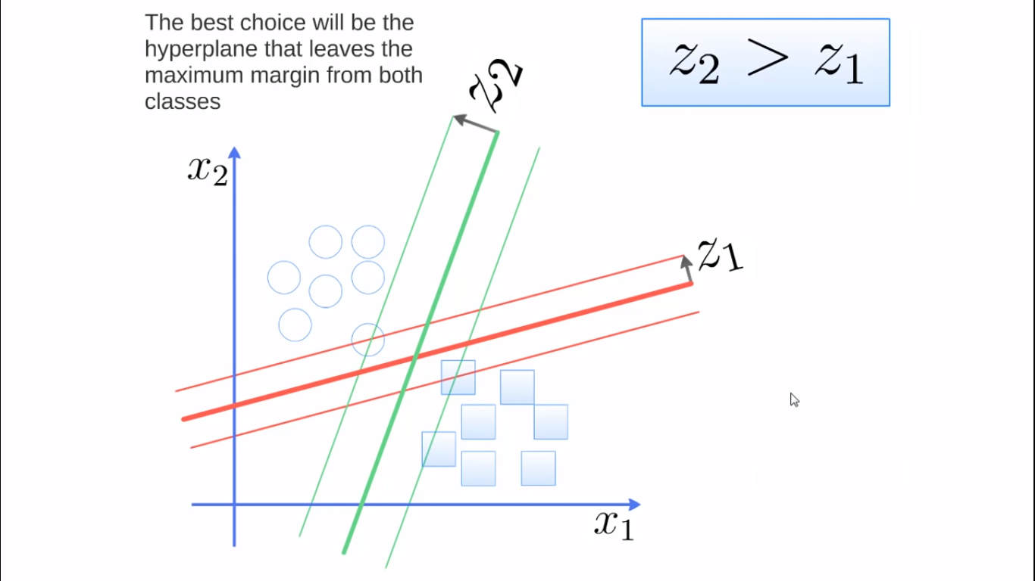
How Support Vector Machine Work

Slide 23
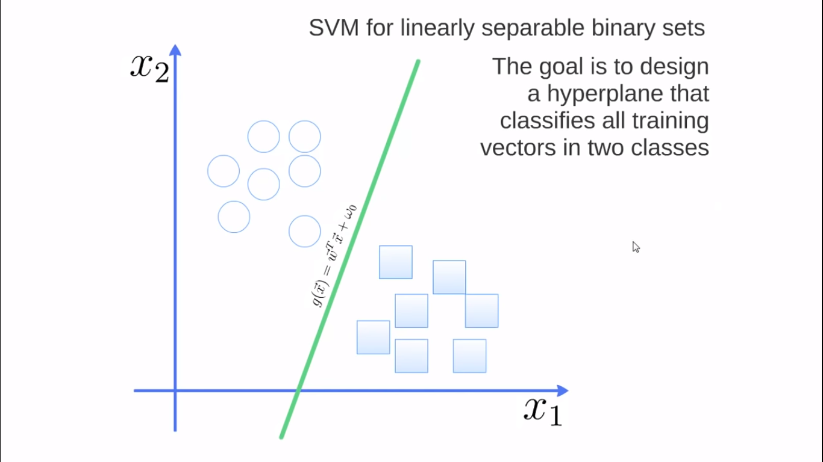
Cont’d

Slide 24
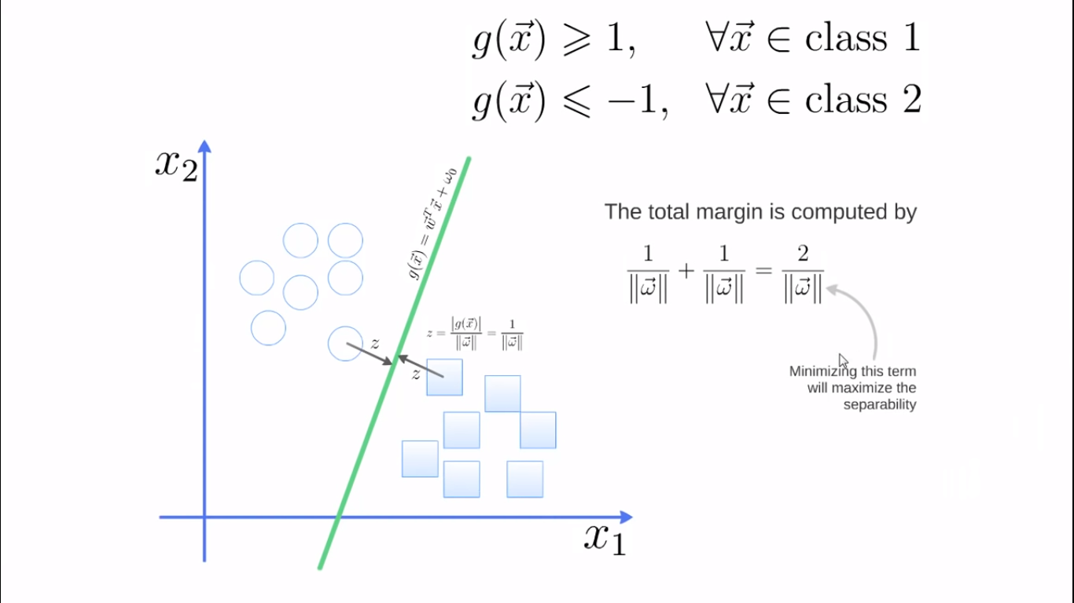
Cont’d

Slide 25
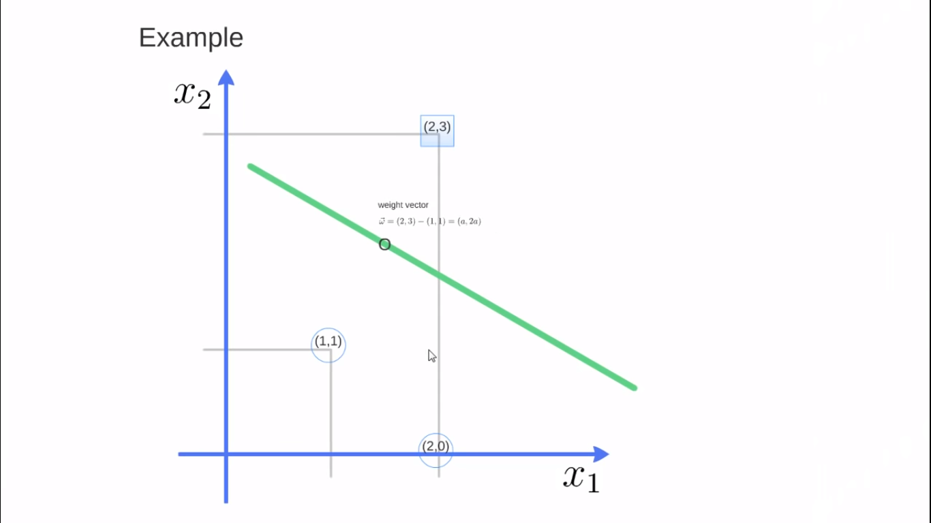
Cont’d

Slide 26
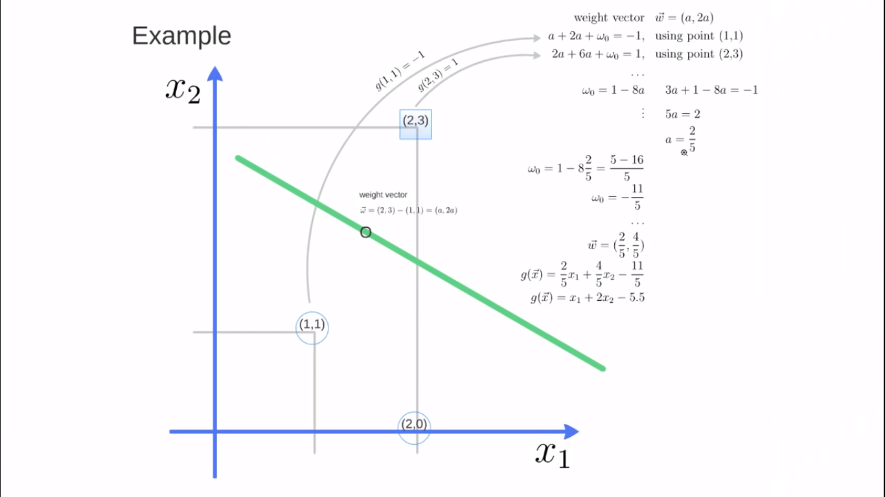
Cont’d

Slide 27
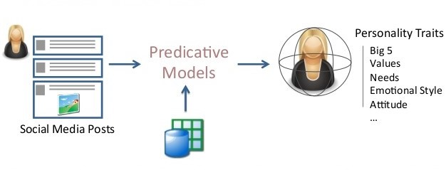
System Overview

Slide 28
Training process
Testing process
Personality
Dataset
User’s Text retrieved from Twitter API
Pre-processing
Filtering
Tokenization
Pre-processing
Filtering
Tokenization
Feature Extraction
Using TF-IDF
Feature Extraction
Using TF-IDF
Classification process using Support Vector Machine
Personality result
Primary characteristics
Secondary characteristics
Fig. System Flow Diagram

Slide 29
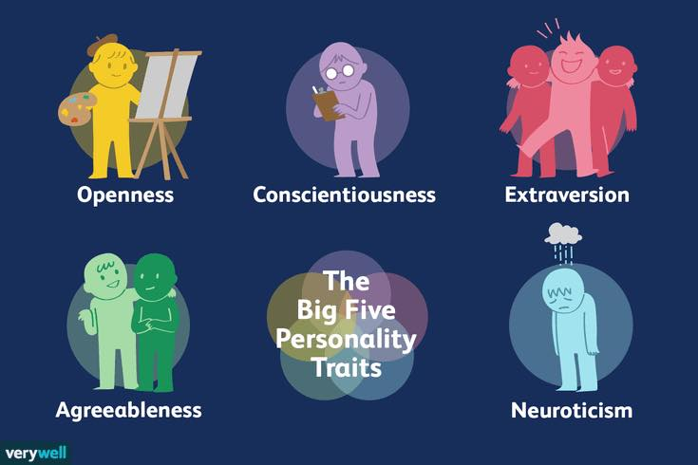
Big Five Personality Traits

Slide 30
Expected Output
The system will generate the personality of a person based on Big Five Personality Traits with relevant percentage value and Yes/No for each trait.

Slide 31
Future Work(For Next Seminar)
Best Classification for training and testing data

Slide 32
THANK FOR
YOUR
ATTENTION!!!

